Slide 1

Sentiment Analysis on Rotten Tomatoes Movie Reviews
AIT 526 PROJECT PRESENTATION
8 May 2023
TEAM 2
BRYAN VEGA
SRIVIDYA PANCHAGNULA
TERRY HILL
ZHONGJIA LIAO

Slide 2
Project Introduction
Conducting sentiment analysis on movie reviews from Rotten Tomatoes to gain insights into people's opinions and emotions towards movies.
Using natural language processing techniques to identify the polarity of movie review comments as positive, negative, or neutral.
Collecting and cleaning the dataset, preprocessing the data, and exploring the dataset to gain insights into the distribution of reviews and the sentiment towards different movies.
Training and testing the sentiment analysis model using various machine learning algorithms and evaluating its performance using standard metrics. (Logistic Regression, Decision Tree, k-NN)

Slide 3
Dataset Acquisition
The dataset is available in CSV format from Kaggle.com and can be used for various purposes, such as sentiment analysis, natural language processing, and machine learning applications in the movie industry.
The Rotten Tomatoes Movies and Critic Reviews Dataset contains information on 17,790 movies and 544,296 critic reviews from 2000 to 2021.
The dataset was created by scraping review data from the Rotten Tomatoes website.
The dataset size is over 1 million rows of data in CSV format
The Rotten Tomatoes Movies dataset includes information on movie title, release date, rating, director, writer, actors, production company, critic reviews, genre, and audience reviews.
The Rotten Tomatoes Critic Reviews Dataset includes fields such as Review_score, Review_date, Review_content, Rotten_tomatoes_link, Critic_name, Top_critic, Publisher_name, and Review_type.

Slide 4
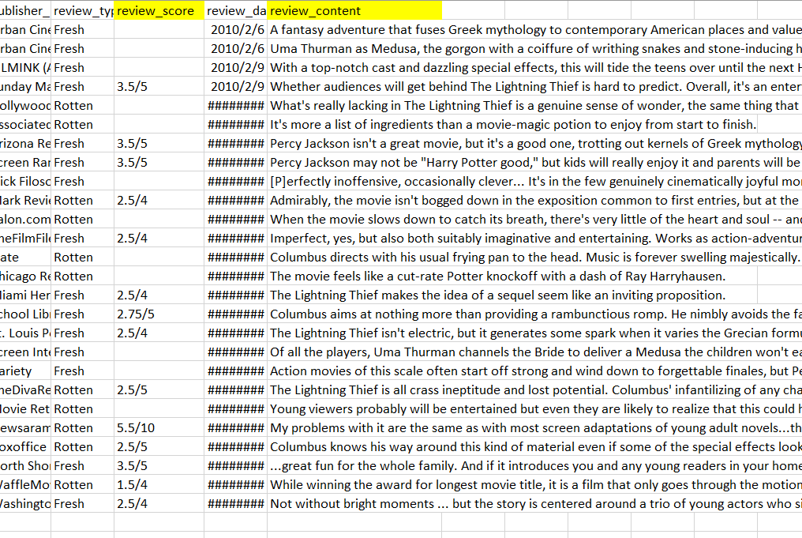
Data Preprocessing
Data preprocessing is essential to ensure the data is appropriate to build the model and perform analysis.
Procedures include identifying and removing null values, and converting the review content column to lowercase.
NLP text preprocessing is also incorporated, including removing special characters, punctuation, and spaces.

Slide 5
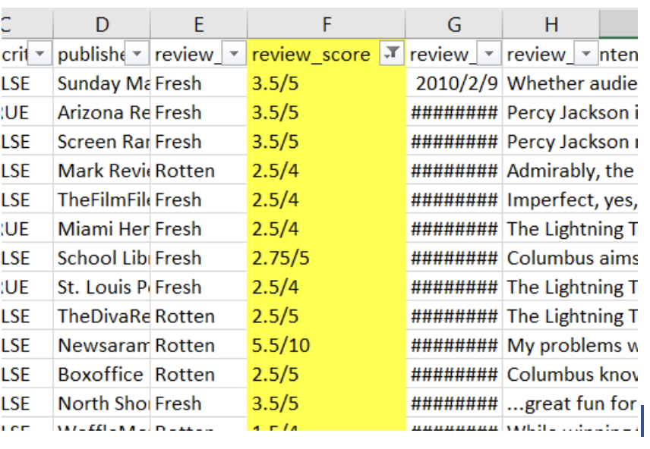
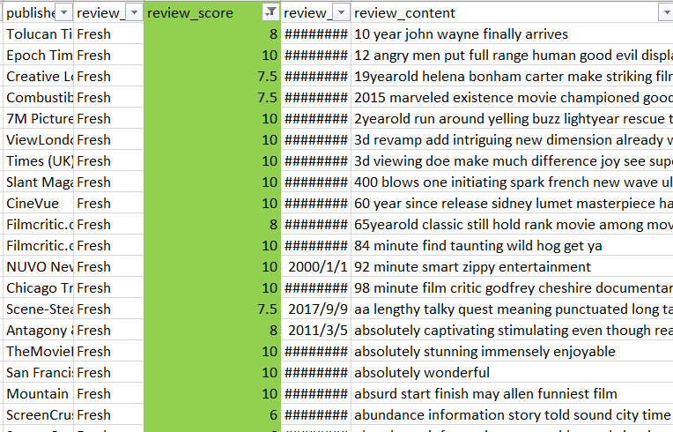
Feature engineering
feature engineering was used to transform the raw data into a format that is more suitable for the data analysis.
The original dataset included a review score column with different scales, which was transformed/consolidated into a scale of 10 ratings using feature engineering techniques.
Feature engineering can also help to reduce the dimensionality of the data, and reduce noise.

Slide 6
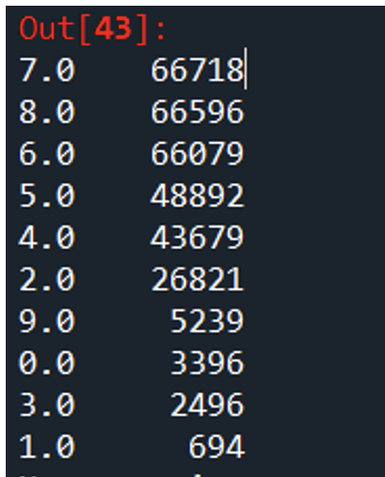
Exploratory Data Analysis
Exploratory analysis helps to summarize and visualize the main characteristics of a dataset.
It helps to gain insights into the data, identify trends, patterns, and outliers that might not be apparent from the raw data.
The number count of the review score was plotted to provide a basic understanding of the dataset.
Based on the output of the number count, we were able to conclude that the majority of the movie reviews had a score of 5 or higher.
Exploratory analysis is an important step in data analysis as it helps to identify important features and relationships that can be used to build accurate models.

Slide 7
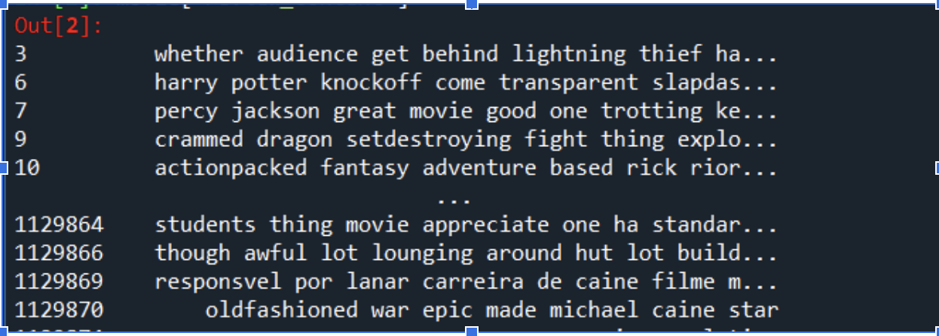
Stemming
Stemming is a natural language processing (NLP) technique to reduce words to their base form.
The goal of stemming is to improve analysis and model accuracy by reducing the number of duplicate words with the same meaning.
For example, stemming might convert "come", "came", and "coming" to the root word "come".
Stemming can be useful in various NLP tasks, including information retrieval, text classification, and sentiment analysis.

Slide 8
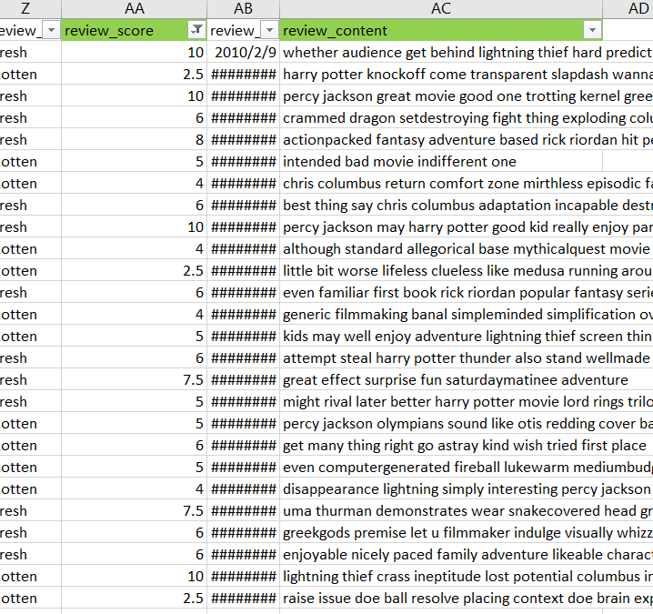
Data Processing (cont)
Text normalization techniques include expanding contractions, and speech tagging.
Stopword removal involves removing common words that do not add much meaning to the text.
Tokenization involves splitting the text into individual words, which can be used as features by machine learning algorithms.
Vectorization involves converting the text data into a numerical format that the machine learning algorithms can use, such as the TF-IDF algorithm.

Slide 9
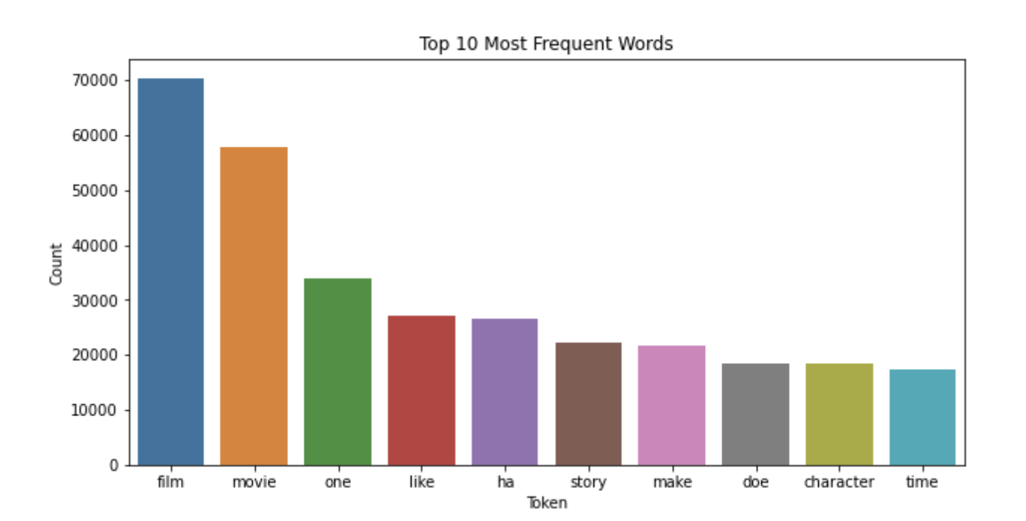
Text Analysis
Text analysis is the process of extracting insights from unstructured text data.
One common technique in text analysis is identifying frequently used words.
Word frequency analysis involves counting the number of times a word appears in a text or corpus of texts.
Text analysis can reveal patterns and trends within data, providing valuable insights into topics and themes being discussed.

Slide 10
Bigrams and Trigrams of Text analysis
Bigrams and trigrams are a type of text analysis technique that involves identifying pairs or groups of words that appear frequently together in a text or corpus of texts.
Bigrams consist of pairs of words, while trigrams consist of groups of three words.
By analyzing bigrams and trigrams, it is possible to identify patterns and relationships between words, providing valuable insights into the topics and themes being discussed.
Bigrams and trigrams can be identified using tools such as NLTK (Natural Language Toolkit) or scikit-learn in Python.

Slide 11
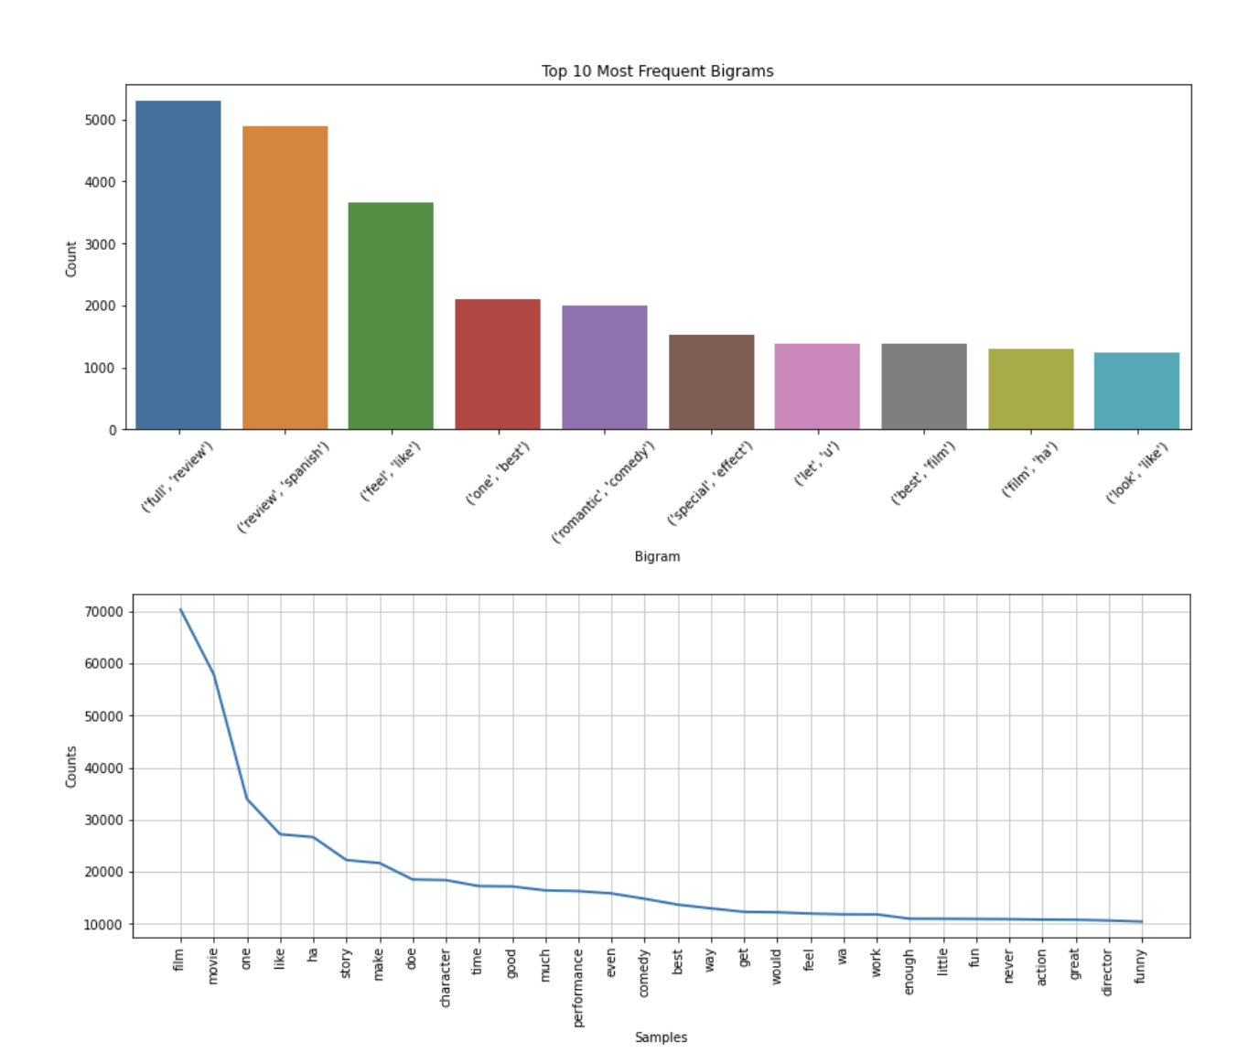
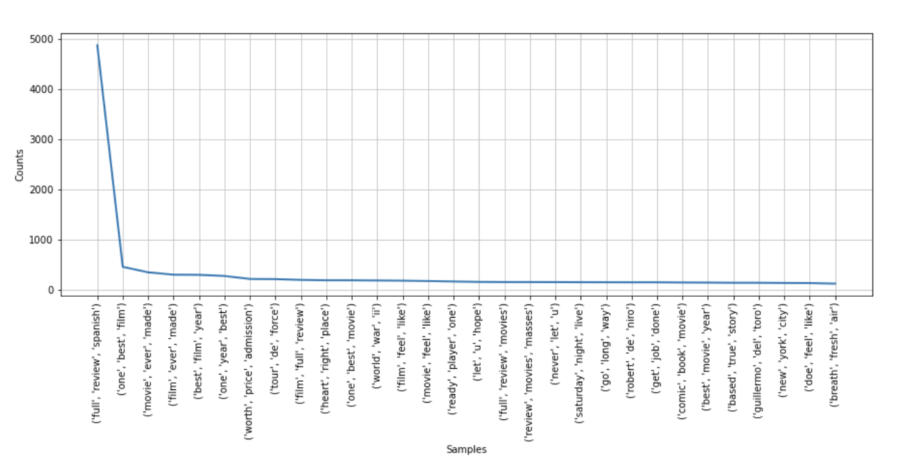

Slide 12
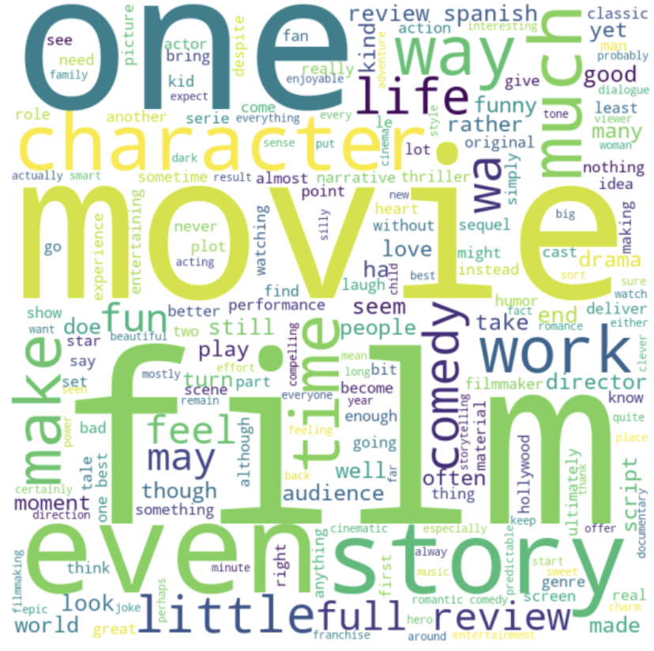
Word Cloud
Word Cloud analysis is a visualization technique which allow users to view the big picture of the text data of which words have the highest frequency within the data.
Word Cloud!!

Slide 13
Analytics and Model Development
Sentiment Analysis - Text Blob
NLTK is a Python package used for natural language processing and sentiment analysis.
It provides libraries and programs for symbolic and statistical NLP for English.
NLTK offers functions like WordNet, Stemming, Tagging, Semantic reasoning to process text data.
TextBlob is another powerful Python package for text data processing and sentiment analysis.
TextBlob can identify part-of-speech tagging for each word, flagging nouns, verbs, and adjectives.
TextBlob sentiment analysis function can determine if the tone of the text data is negative, neutral, or positive

Slide 14
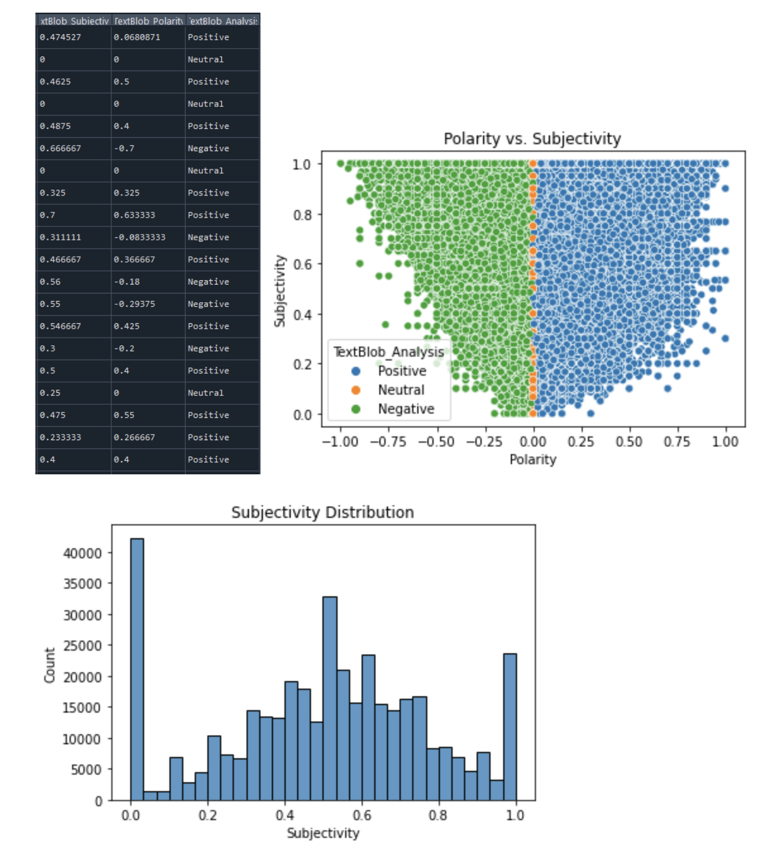

Slide 15
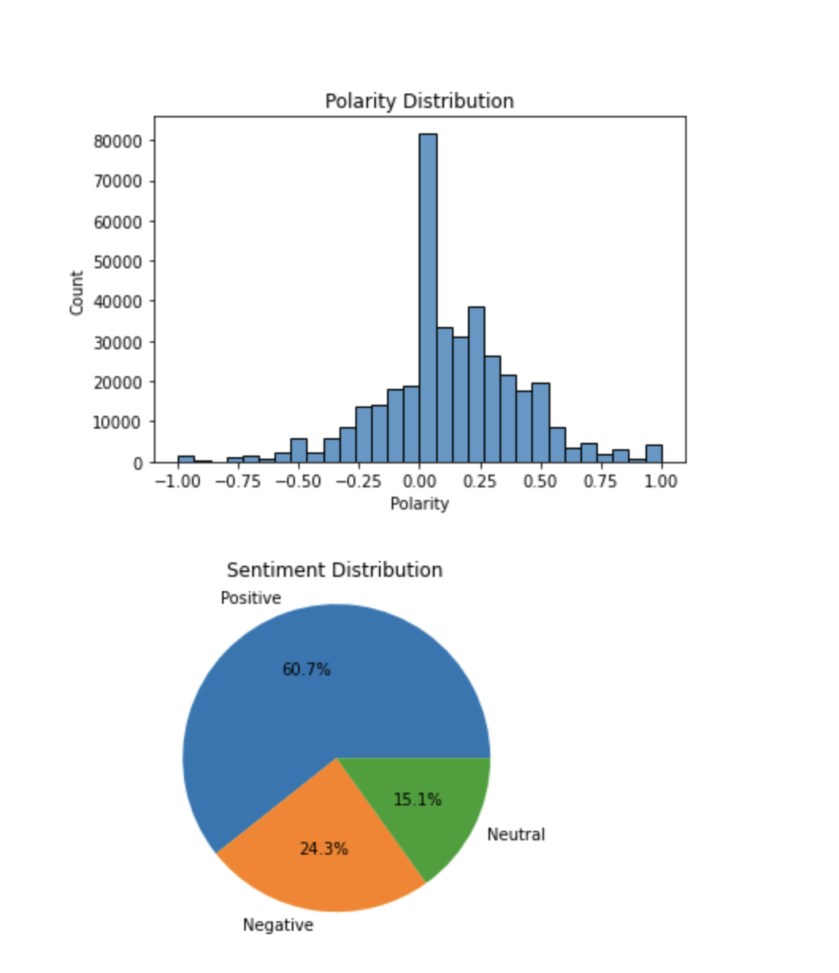
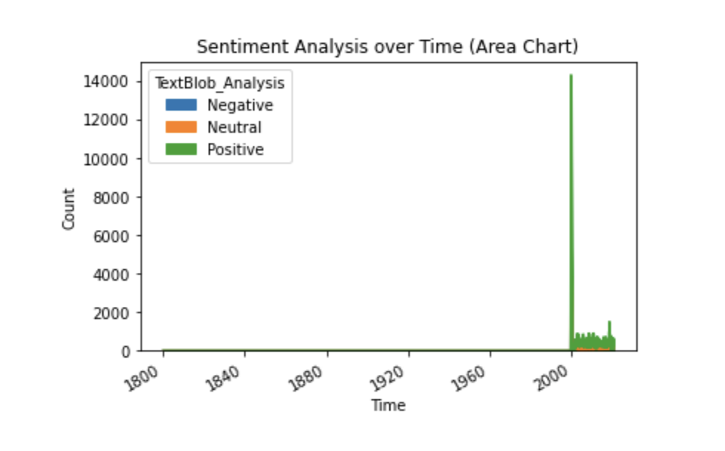
Sentiment analysis time series is a technique used to analyze changes in sentiment over time. It involves analyzing sentiment data from movie reviews over a period of time.
A pie chart displays the percentage of reviews in each category, providing a quick and easy-to-understand overview of the overall sentiment towards the movie.
The size of each slice of the pie chart corresponds to the percentage of reviews in each category.

Slide 16
Model Development
80/20 training/testing split
TF-IDF vectorization
Logistic Regression, Decision Tree, k-NN
Confusion Matrix Heatmap evaluation
Best model chosen by accuracy and balance of predictions (F-1 Score)

Slide 17
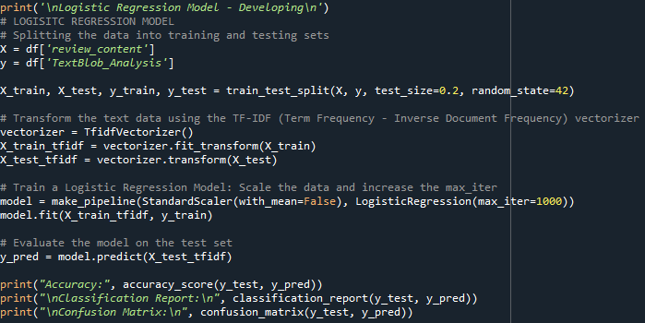
Model Characteristics (Logistic Regression)
Widely-used ML algorithm
80% training set, 20% testing set
TF-IDF vectorization
Data standardization: StandardScaler
1000 iteration training
Evaluation metrics: accuracy, classification report,
confusion matrix
Visualization: heatmap, ROC curves

Slide 18
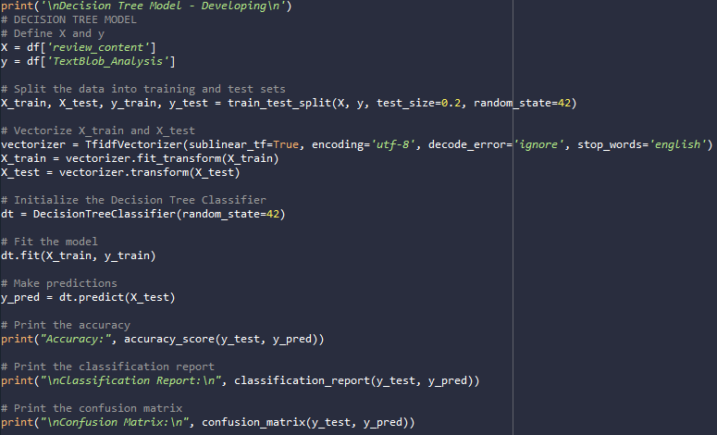
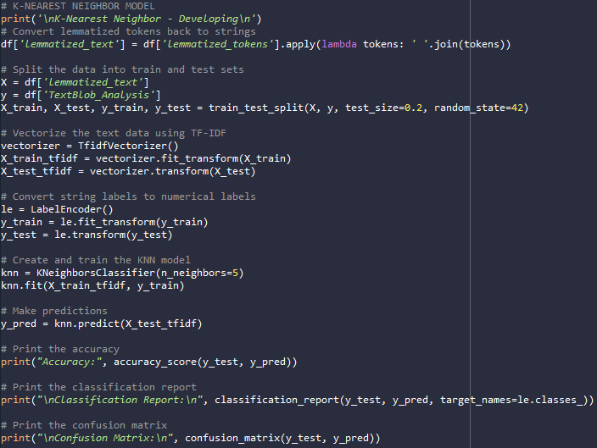
Model Characteristics (Decision Tree and k-NN)
Decision Tree: widely-used ML algorithm
Trained with the same training set as Logistic Regression
Evaluation metrics: accuracy, classification report, confusion matrix
Visualization: heatmap, ROC curves
k-NN: instance-based learning algorithm
Trained using the training set

Slide 19
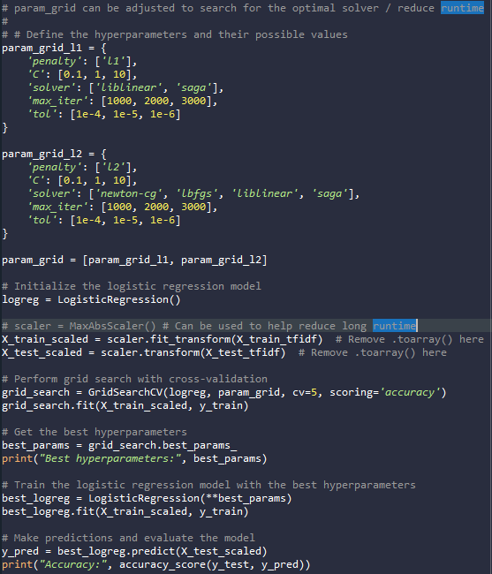
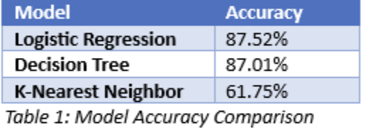
Model Selection
Logistic Regression: most suitable choice
Highest accuracy: 0.875
Strong precision, recall, F1-score
Macro average F1-score: 0.84
Superior predictions across classes
Better balance between true positives and false positives/negatives

Slide 20
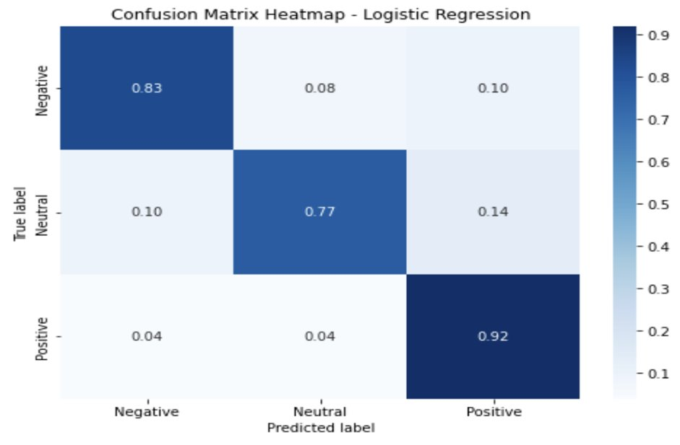
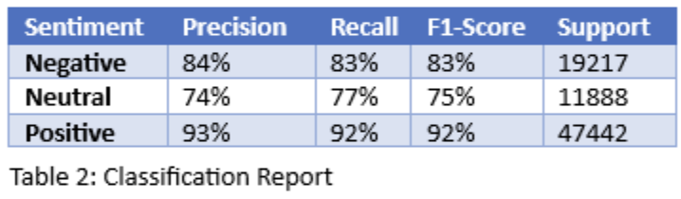
Visualizations and Analysis
Classification Matrix
Precision: Negative 0.84, Neutral 0.74, Positive 0.93
Recall: Negative 0.83, Neutral 0.77, Positive 0.92
F1 Score: Negative 0.83, Neutral 0.75, Positive 0.92
Accuracy: 88%
Confusion matrix
Negative: 83% correct, 8% misclassified as Neutral, 10% as Positive
Neutral: 77% correct, 10% misclassified as Negative, 14% as Positive
Positive: 92% correct, 4% misclassified as Negative or Neutral

Slide 21
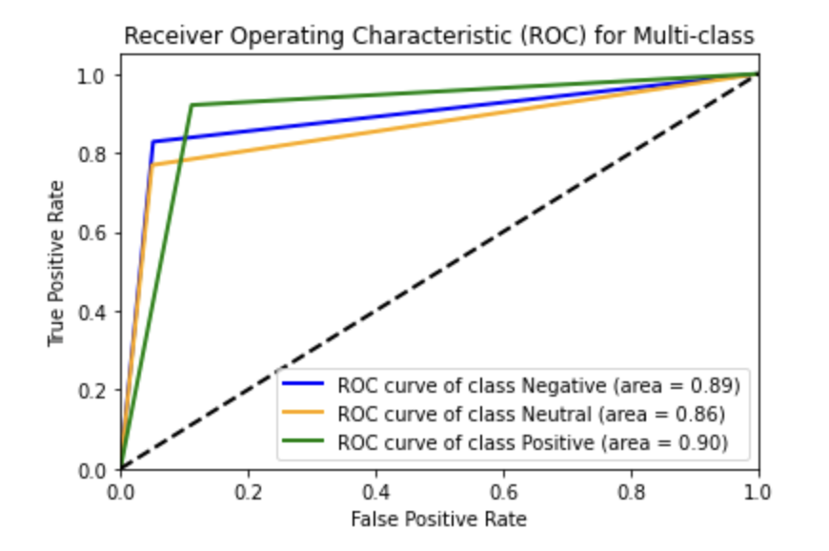
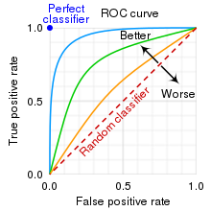
Receiver Operating Characteristic (ROC) Curve
AUC: Negative 0.89, Neutral 0.86, Positive 0.90
Strongest performance: Positive class
Weakest performance: Neutral class
What to look for…

Slide 22
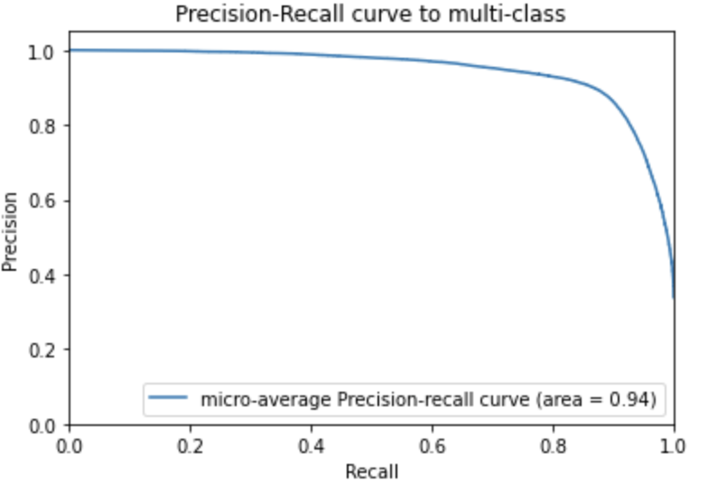
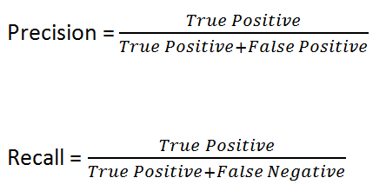
Precision-Recall Curve
Micro-average PR curve: 0.94
High precision and recall across all classes
Effective classification performance with class imbalance and varying thresholds

Slide 23
Conclusion
The sentiment analysis model was trained and evaluated using various machine learning algorithms and performance evaluation metrics, with the Logistic Regression model selected as the best performing model.
The model demonstrated strong performance in identifying Positive instances, but weaker performance for Neutral instances.
The model's performance was visualized using a confusion matrix, ROC curve, and Precision-Recall curve.
The project provided insights into people's opinions and emotions towards movies, including sentiment towards different genres, actors, directors, and production houses, as well as comparisons between different groups of reviewers.
Natural language processing techniques such as TF-IDF were utilized to preprocess and analyze the dataset, demonstrating the importance of effective data cleaning and preprocessing for machine learning tasks.
The project highlights the potential value of sentiment analysis for understanding public opinion and perception, with applications in industries such as marketing and public relations.

Slide 24
References
Online Resources
Bird, S., Klein, E., & Loper, E. (2009). Natural Language Processing with Python: Analyzing Text with the Natural Language Toolkit. O'Reilly Media, Inc.
"Scikit-Learn User Guide." Scikit-Learn. https://scikit-learn.org/stable/user_guide.html
"Understanding ROC Curves." Towards Data Science. https://towardsdatascience.com/understanding-auc-roc-curve-68b2303cc9c5
Parthvi Shah. (2020). Sentiment Analysis using TextBlob. Retrieved from https://towardsdatascience.com/my-absolute-go-to-for-sentiment-analysis-textblob-3ac3a11d524
Python Libraries
Pedregosa, F., et al. (2011). Scikit-learn: Machine Learning in Python. Journal of Machine Learning Research, 12, 2825-2830. https://scikit-learn.org/stable/
NLTK Project. (n.d.). NLTK 3.6.2 documentation. Retrieved from http://www.nltk.org/
Loria, S. (n.d.). TextBlob: Simplified Text Processing. Retrieved from https://textblob.readthedocs.io/en/dev/

Slide 25
The End
Team 2

